Slide 1

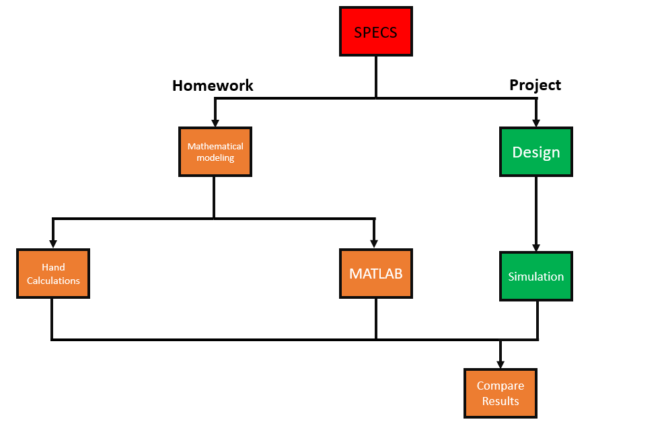
Project 3 – Part 1
Design Flow
DONE BY:
DHRUV KRISHNAMURTHY CHITTI BABU (1226130635) &
MRUDHULESH KURAPATI (1226364206)
Part 1

Slide 2
Project 3 Overview
WIFI 5 (802.11ac)
Wi-fi 5 is described by the IEEE 802.11ac.
Operating Frequency 5GHz.
Bandwidths of up to 160MHz.
Data rates more than 400Mbps.
Objectives:
Understand the requirements of the standard.
Read through the datasheets of off-the-shelf components.
Implement FRIIS tabulations of the various parameters.
Verify FRISS model in MATLAB.
Compare hand calculations with MATLAB model.
Reading about the standard
802dot11ac_A_Survival_Guide.pdf (cmu.edu)
What is WiFi 5 (802.11ac)? (purple.ai)
IEEE 802.11ac-2013 - Wikipedia

Slide 3
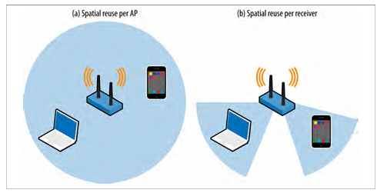
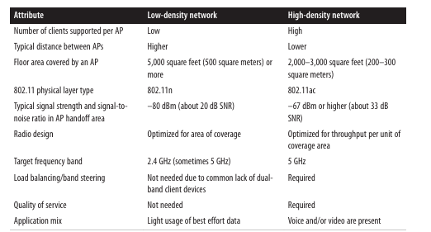
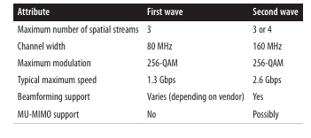
Project 3 Overview
Our goal is to design an implement a spatial reuse access point on the Wi-Fi 5 standard.
The specifications suggest coverage area of 2000sq feet, we are modeling the design for a stadium that pushes the power beyond the requirement mentioned.
The specifications as per determined by the 802.11ac standard.

Slide 4
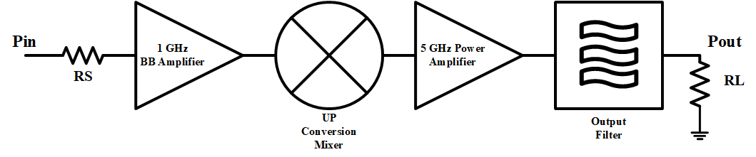
TX Architecture
NOTE: This is a transmitter
We amplify and upconvert the signal to send to the antenna (RL)
Specifications:
Pin = -1 dBm.
Fin = 1 GHz.
Bandwidth = 80MHz.
Fout = 5GHz.
Pout = 24dBm.
Mixer LO Freq = 4GHz.
Mixer LO Power = 0dBm.
YOU DO NOT NEED TO INCLUDE RS IN YOUR SIMULATIONS OR ANALYSIS

Slide 5
Datasheets – COTS
Read the Datasheets:
Please read through the datasheets provided.
There are a total of 3 data sheets included. If you cannot download them from Canvas, please follow the links in the appendix.
The filter does not have a data sheet (Assume perfect matching)
All the necessary/critical specifications are tagged with red lettering for you within the datasheet.
Insertion loss is always often located at the bottom of the datasheet.
If there are any questions, please ask.
YOU WILL NEXT CREATE MODELS FOR THESE COTS PARTS IN MATLAB.

Slide 6
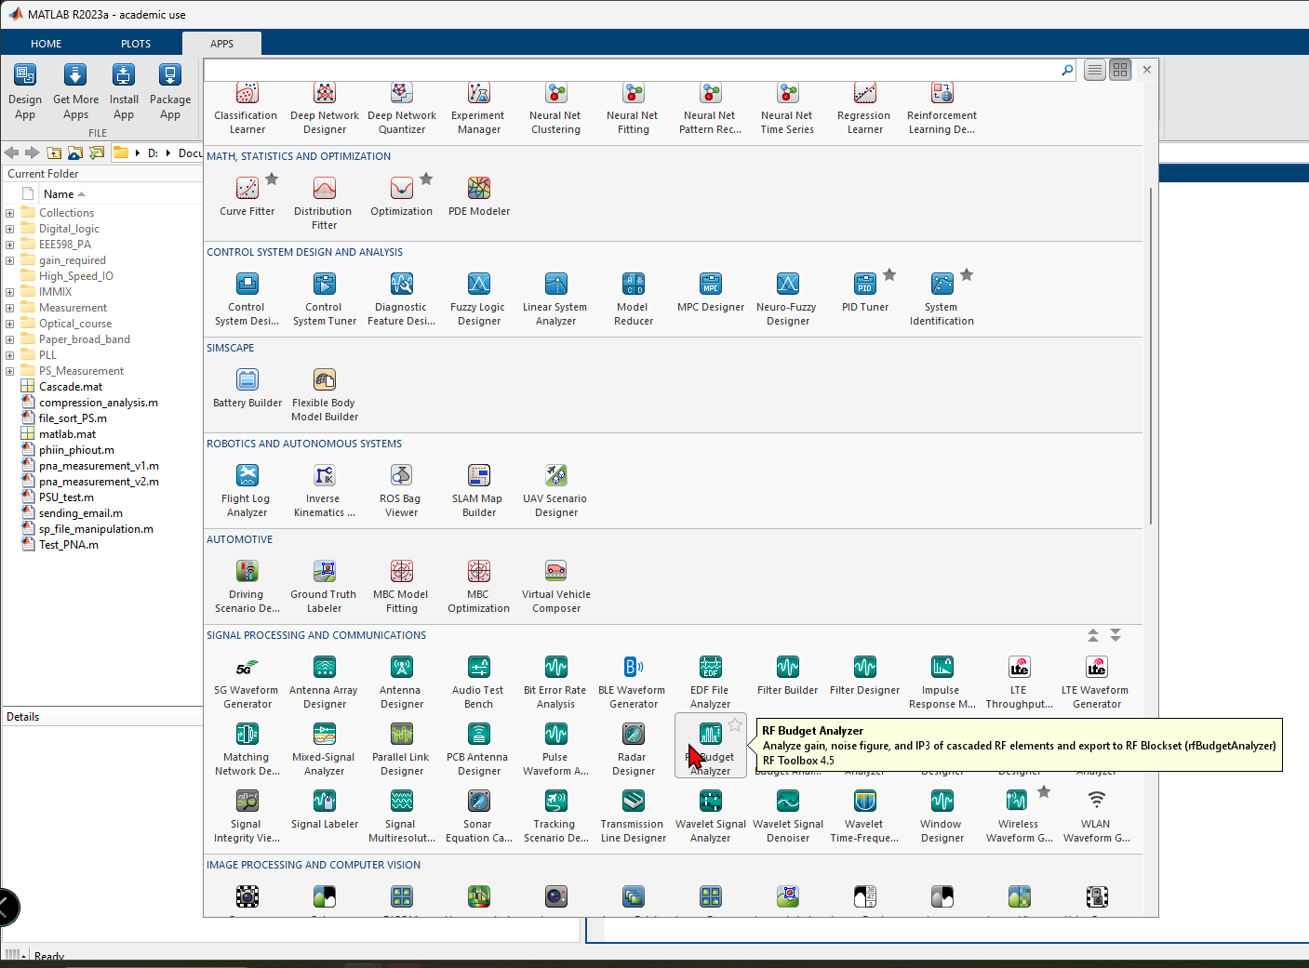
MATLAB Modeling
On the MATLAB main window, switch from “Home” to APPS
In the dropdown menu, select RF Budget Analyzer

Slide 7
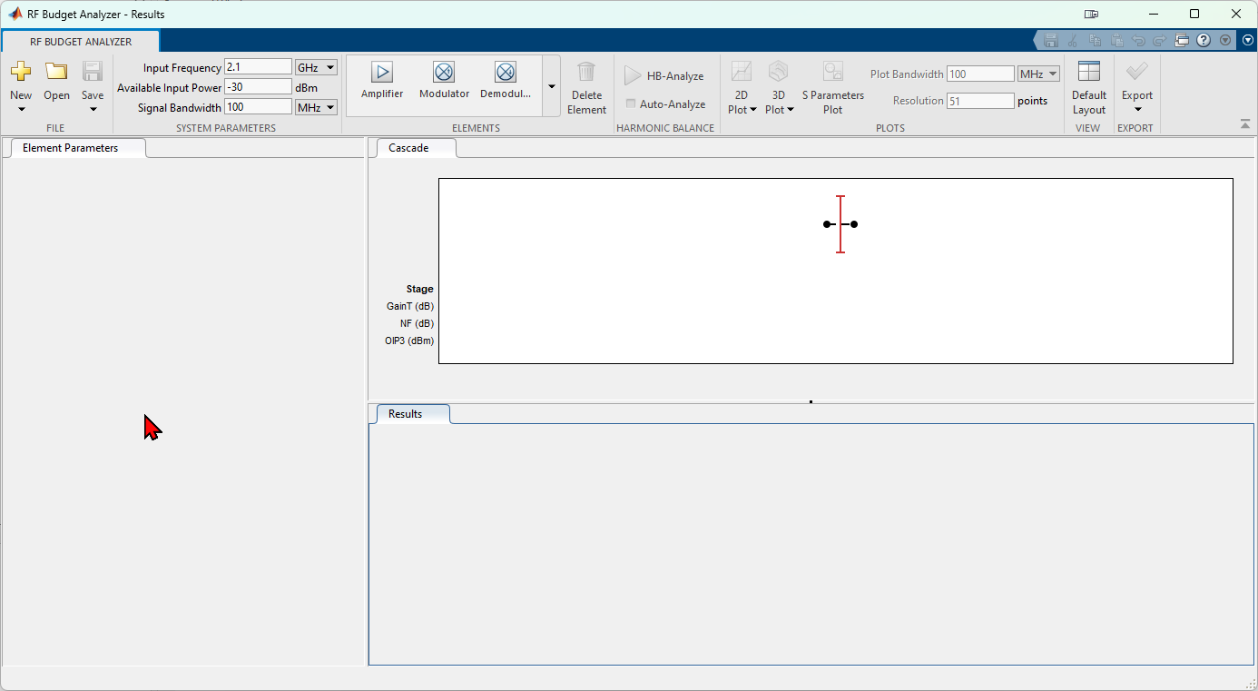
MATLAB Modeling
System Specification:
Specify the input frequency as 1GHz.
Input power to -1dBm.
Set the bandwidth as 80MHz.
Building the System:
Select on Amplifier to add the amplifier to the cascade window.
Modulator to add the upconversion mixer.
Filter for the output filter.

Slide 8
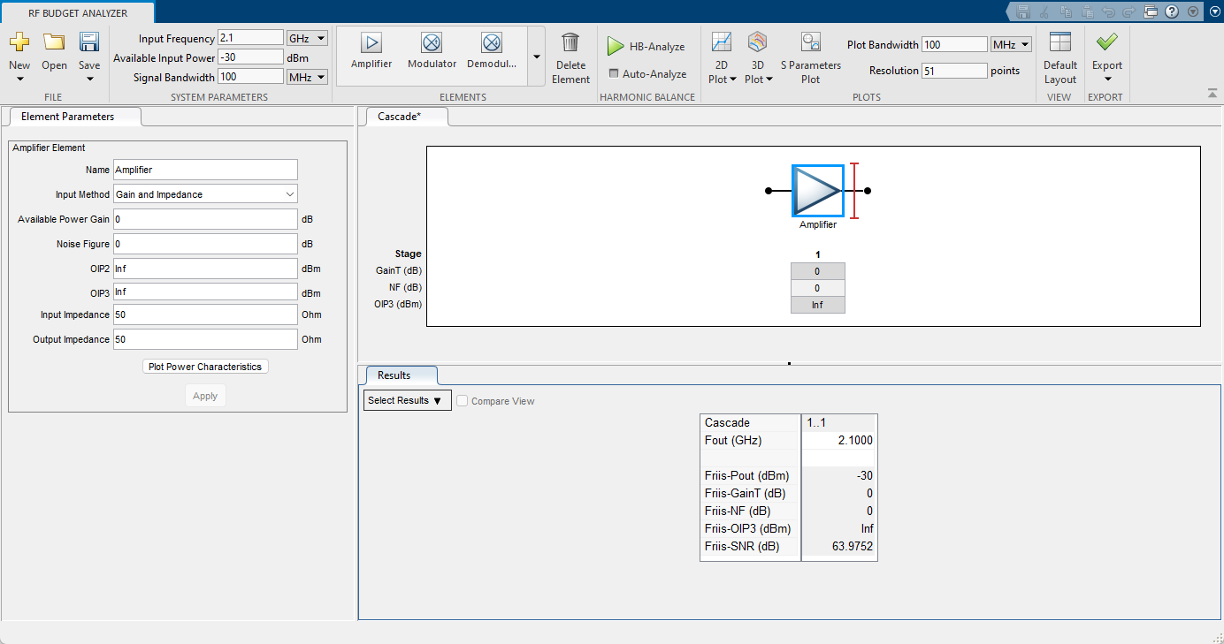
MATLAB Modeling
MATLAB Modeling Amplifier
Amplifier Specification:
Specify the various parameters (boxed in red) of the amplifier from the values from the datasheet.

Slide 9
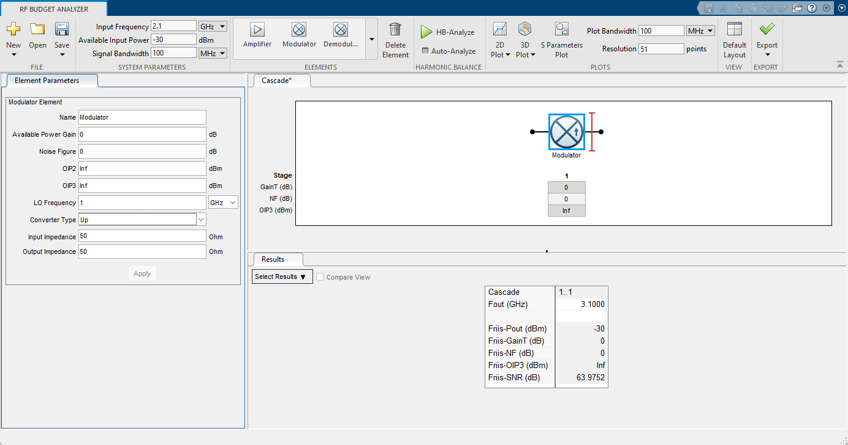
MATLAB Modeling
MATLAB Modeling Mixer
Mixer Specification:
Specify the LO frequency as 4GHz as per the up-conversion frequency required.
Select the conversion type UP.
Specify the various parameters from the values from the datasheet.

Slide 10
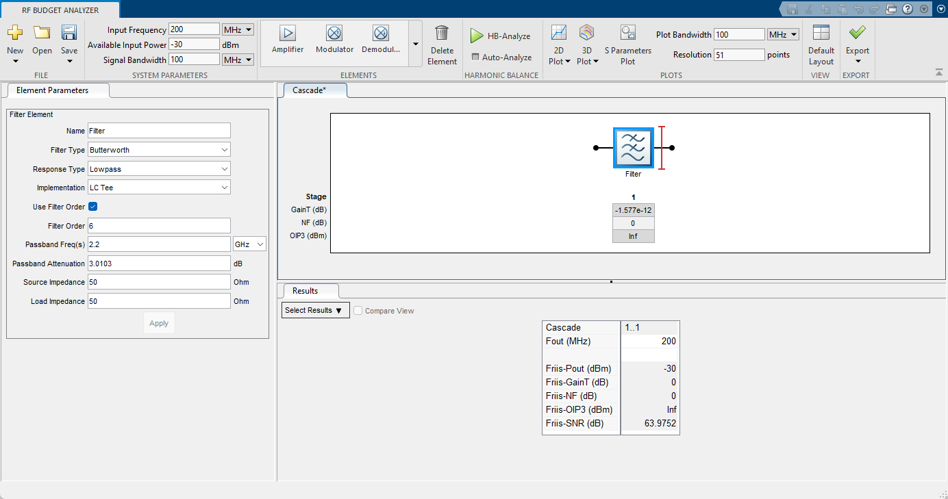
MATLAB Modeling
MATLAB Modeling Filter
Filter Specification:
Set the Filter order to 6.
Set the Response to Bandpass.
Set the implementation to LC Pi.
Set Passband frequencies as [4.5 5.5].
Leave the passband attenuation at default.

Slide 11
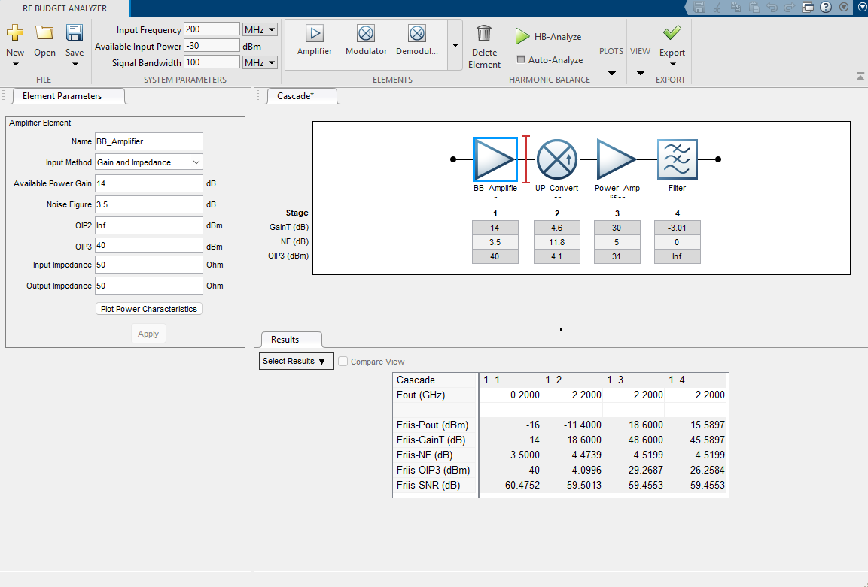
MATLAB Modeling
Final System:
The final window will loosely resemble this with all the components cascaded in the cascade window.
NOTE: USE your own values for parameters based on the datasheets – the figure to the right is only an example.
The subsequent Friis equation shows in the result window.
The next step is to estimate the system performance metrics with the help of Harmonic Balance analysis.
To run Harmonic Balance, click on the HB-Analyze button at the top of the window.
Select 2D plot and plot the following:
Pout.
Gain.
IIP3.
Noise Figure.
MATLAB Modeling - System
Reminder: these should be entered using your input signal specs. See slide 7
*This is for reference purposes only

Slide 12
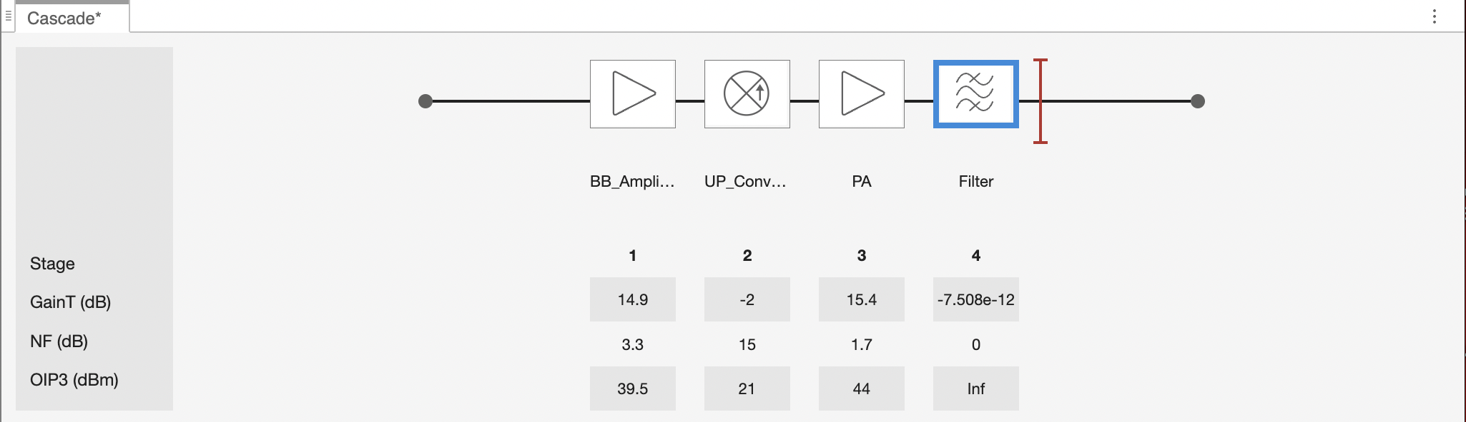
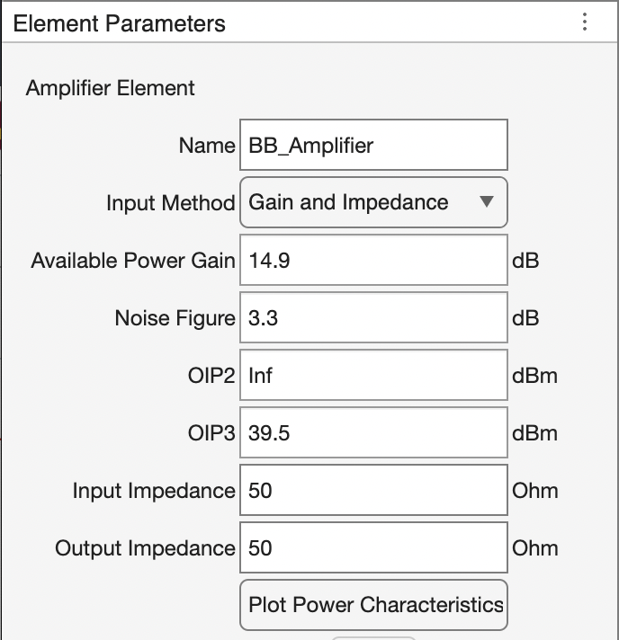
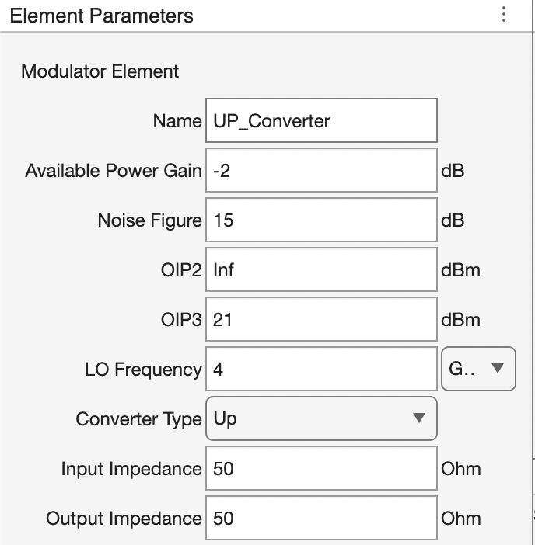
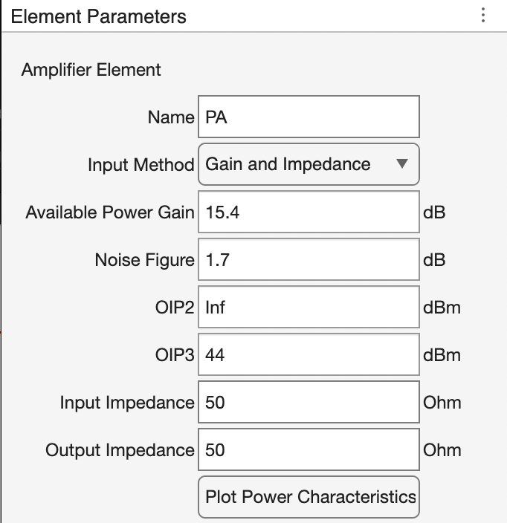
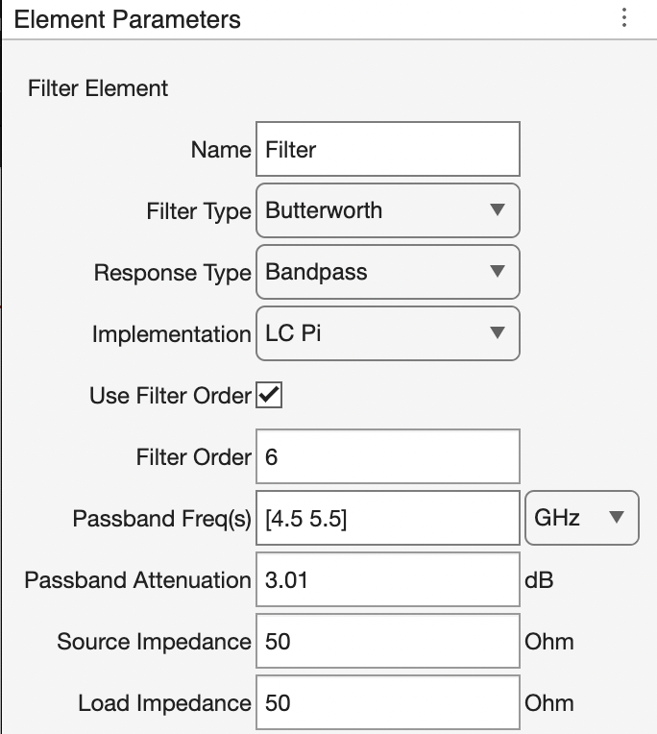
Project Part 1 {REPORT}

Slide 13
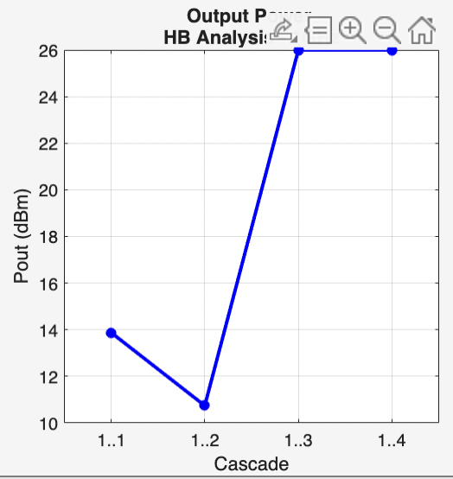
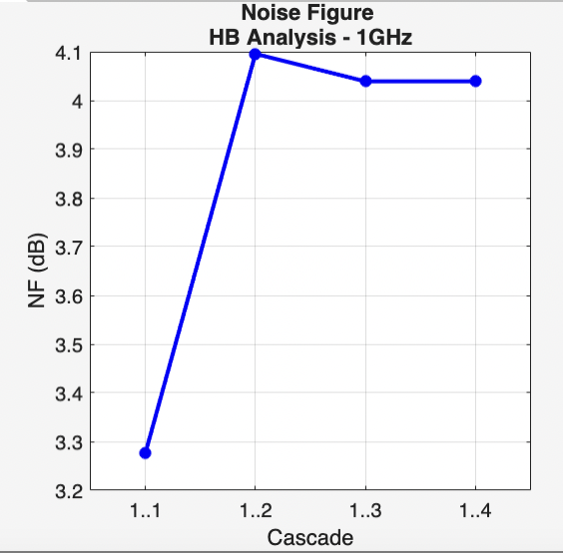
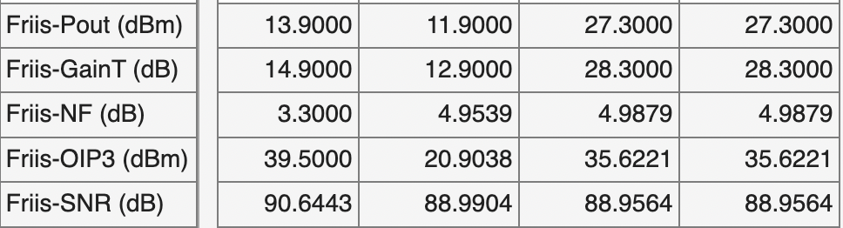
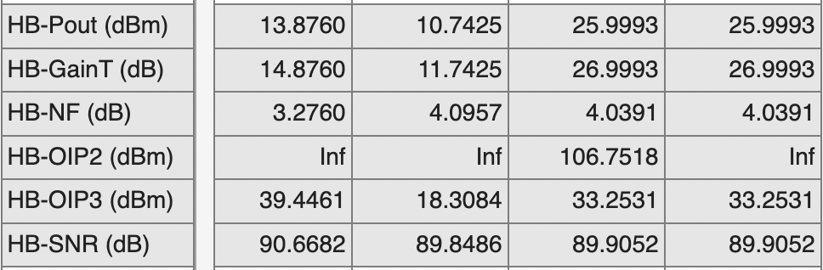
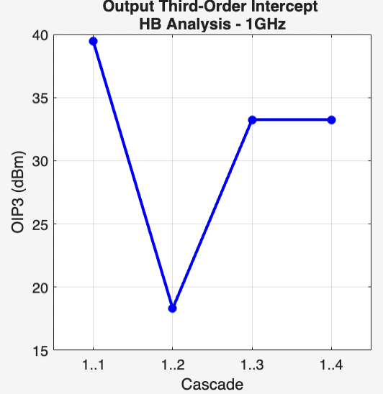
Project Part 1 {REPORT}
FRIIS Table
Power Graph
NF Graph
HB Table
OIP3 Graph

Slide 14
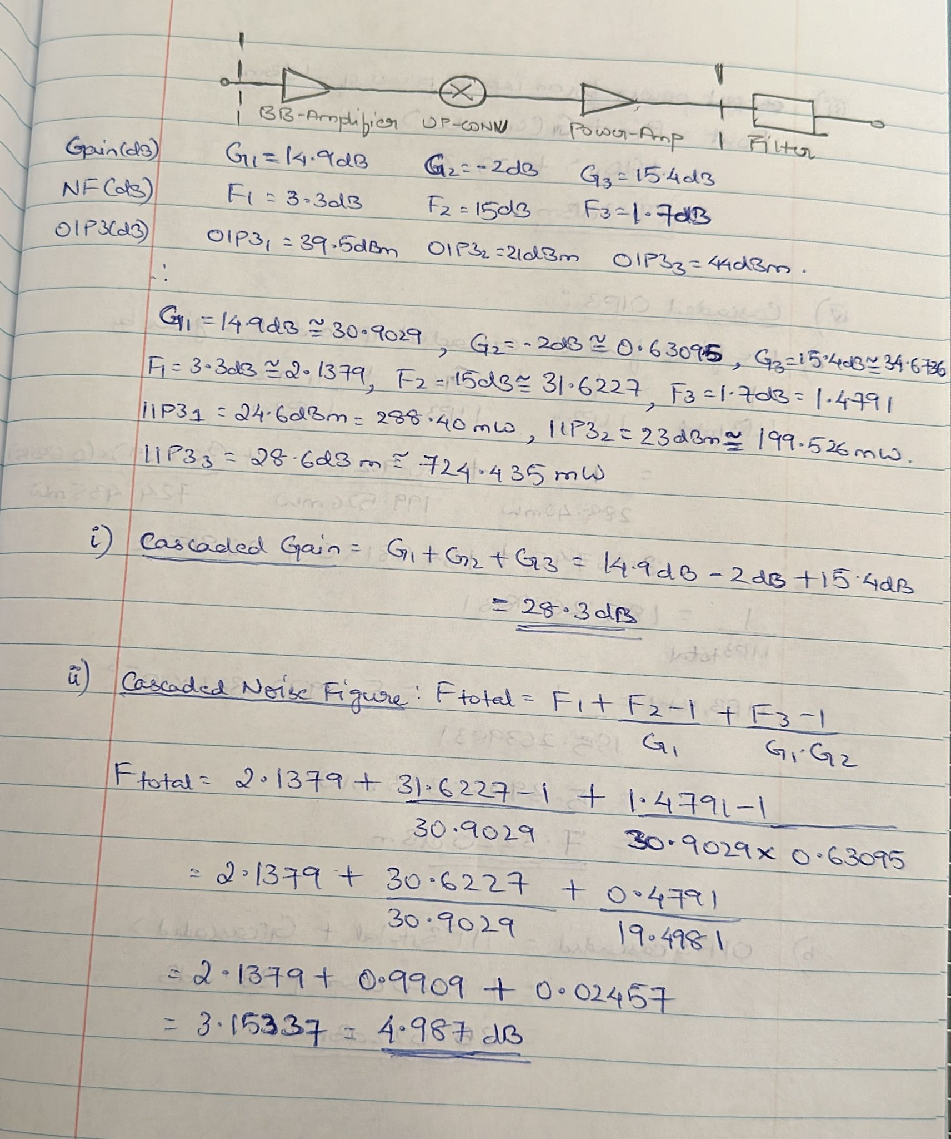
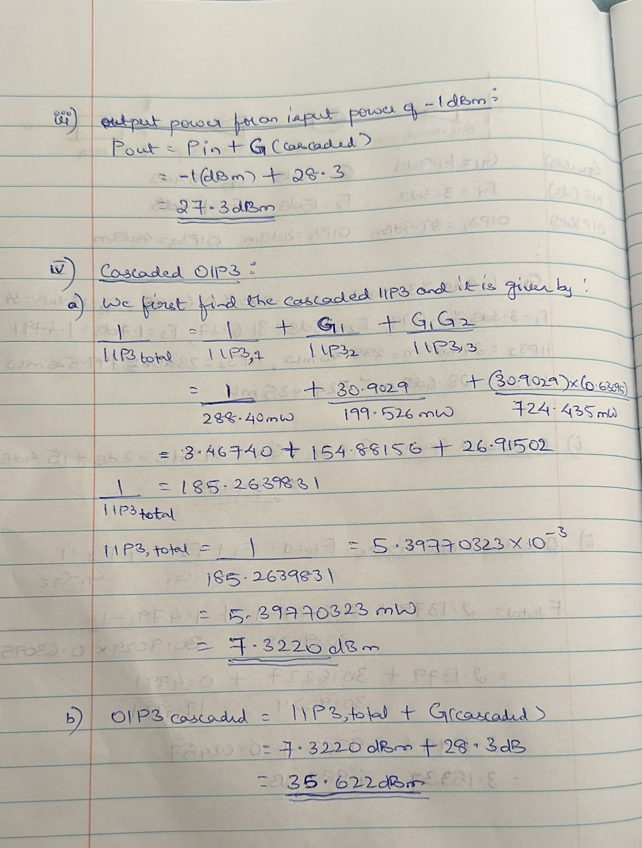
Project Part 1 {REPORT}
Hand Calculations:
Cascaded Gain
Cascaded Noise Figure
Output Power for an Input Power of -1dBm
Cascaded (system) OIP3

Slide 15
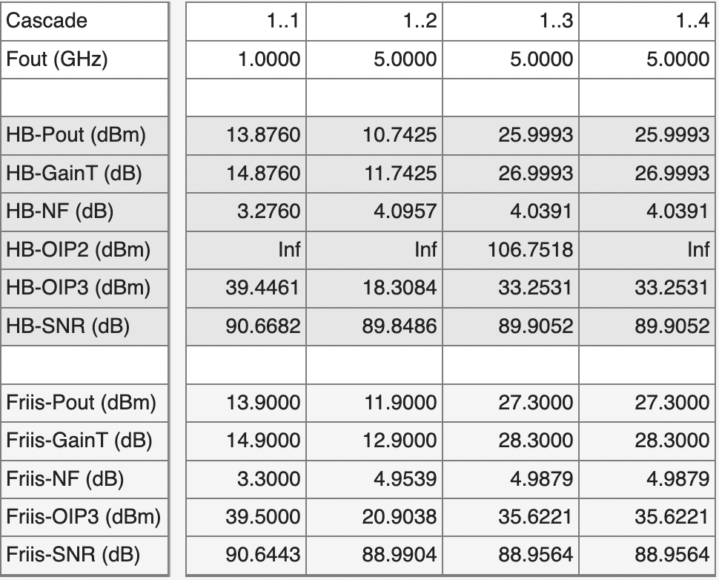
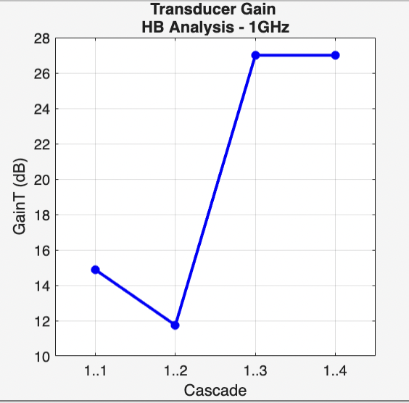
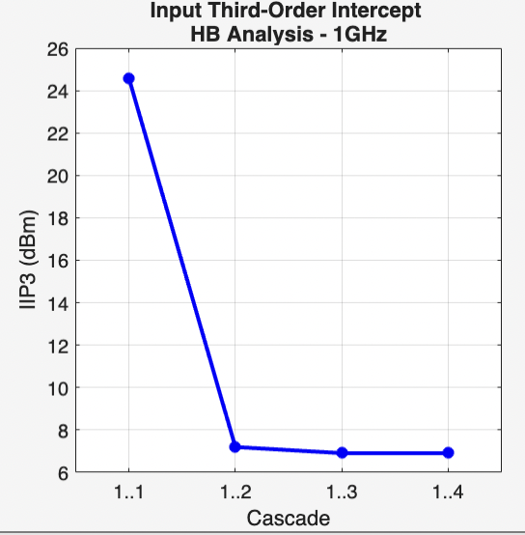
Project Part 1 {REPORT}
Prameters
Gain(dB)
NF(dB)
OIP3(dBm)
Pout(dBm)
Hand Calculation Results | MATLAB Results
28.3 | 28.3
4.987 | 4.987
35.622 | 35.6221
27.3 | 27.3
Table Comparing Hand Calculations and your Matlab Results
MATLAB Results
Transducer Gain Graph
IIP3 Graph

Slide 16
Homework {Appendix}
Datasheet Links
ffc5071_5072_data_sheet-1506879.pdf (mouser.com)
ADL5535.pdf (analog.com)
GRF5511DS-1714274.pdf (mouser.com)
DONE BY:
DHRUV KRISHNAMURTHY CHITTI BABU (1226130635) &
MRUDHULESH KURAPATI (1226364206)

Slide 17
Project 3 – Part 2
Design Flow
Part 2

Slide 18
ADS Simulation of the Transmitter
ADS Simulation:
What will we be learning in this section?
ADS design guide.
Simulating amplifiers and mixers with the help of ADS templates.
Integrating the individual components and building the transmitter.
Simulating the transmitter and noting the various performance metrics.

Slide 19
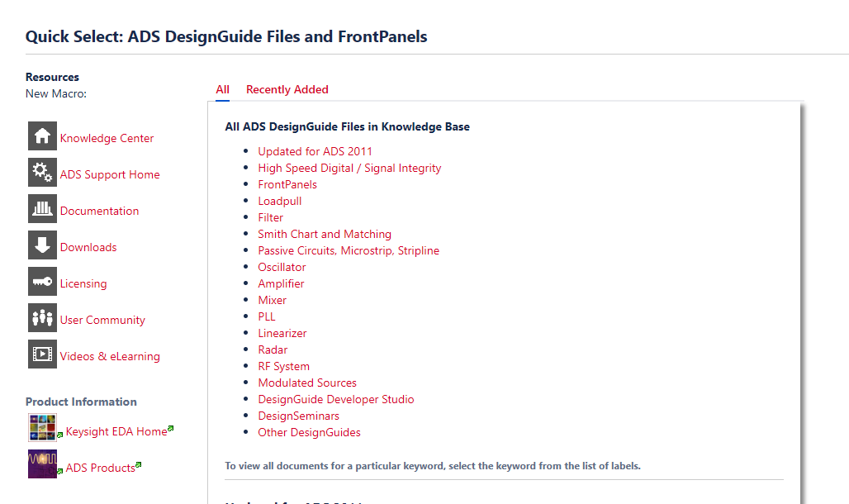
ADS Design Guide
Introduction:
The ADS design guide is a set of pre-built templates for simulating various RF components.
The templates are designed to ease the testing of designs with pre-defined equations, graphs and tables.
We will be simulating the mixer with the help of these design templates.
Finally, we integrate the entire transmitter and use the design guide to estimate the various performance metrics of the same transmitter from Project 3, Part 1.
Desing Guide tutorial on the ADS website.
ADS DesignGuides - ADS DesignGuides - Keysight Knowledge Center

Slide 20
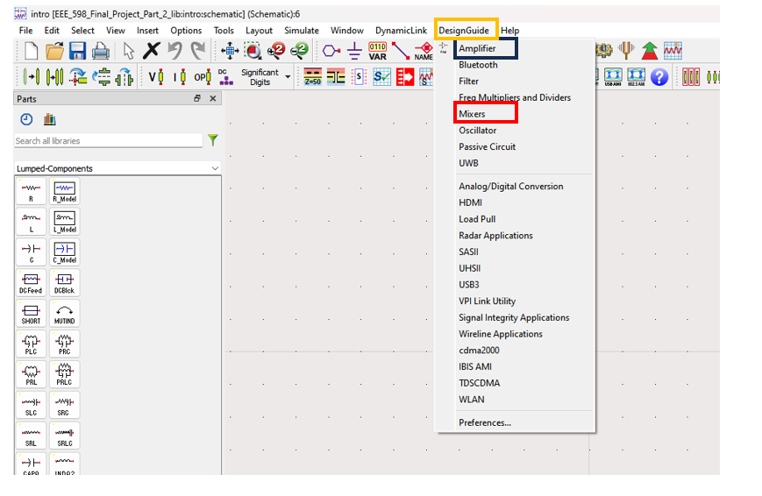
ADS Design Guide
Invoking the Design Guide
Open a blank schematic.
Then click on the design guide button at the top of the toolbar. (Highlighted in Yellow)
We will be using the design guide for the Mixers (Red) in this project.
This will open a sub-menu
We will be using several of these design guide templates in this project.
We are using this design guide category.

Slide 21
Simulations of Stand-alone Mixer
Please save all of your schematics that you create for the Mixer simulations. You will use these schematics again for your Transmitter simulations.

Slide 22
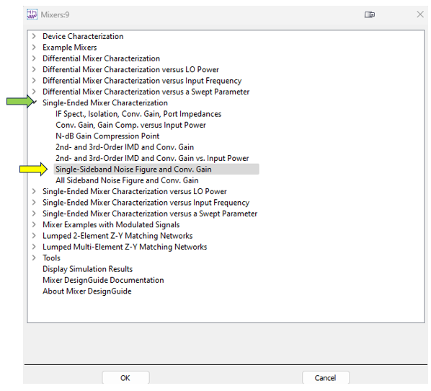
ADS Design Guide {Mixers –NF, Gain(SSB)}
Invoking the Design Guide
Select Single Ended Mixer (Green Arrow).
Select the section highlighted by the arrow, this will open a template schematic (Yellow Arrow).

Slide 23
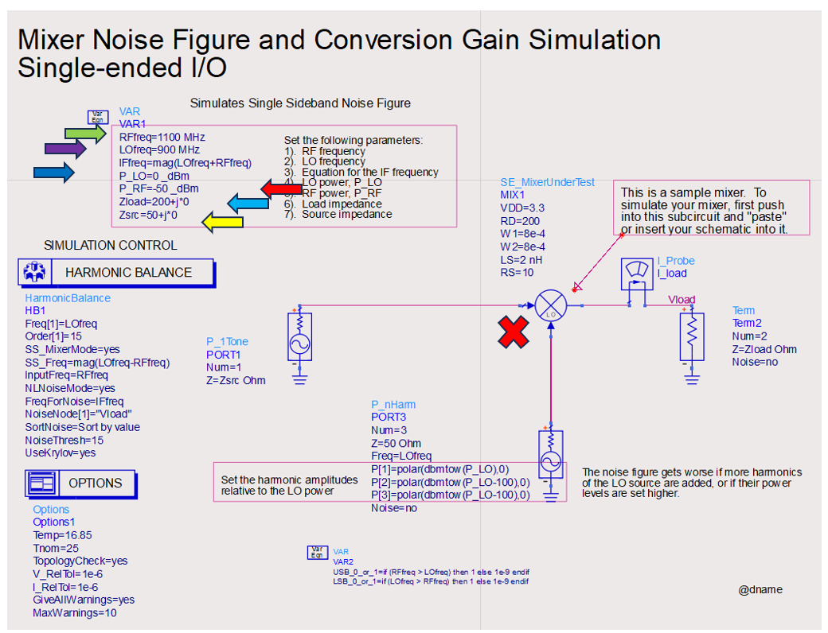
ADS Design Guide {Mixers –NF, Gain(SSB)}
MODIFY the Design guide schematic & simulate:
In the schematic attached to the design guide, delete components marked with the “X” (delete the pre-populated mixer)
Replace the mixer in the center of the schematic with your mixer. See next 2 slides for how to instantiate your mixer w/behavioral model.
Change the RF frequency to the required value (Green Arrow).
Change the LO frequency to the required value (Purple Arrow).
Change the LO power to the required value (Navy Blue Arrow).
Change the RF power to the required value (Red Arrow).
If the impedances are not at 50 ohms change them to 50 ohms (Yellow and Light Blue Arrow).
Run the simulation.

Slide 24
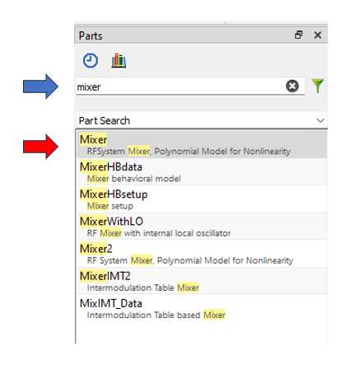
Insert Component from Palette
How to insert your mixer component:
Mixer
The components in the design guide schematic are replaced with ideal (behavioral model) components from the component palette.
Search for the Mixer component as shown to the right in the component palette.
Place the mixer into the schematic (previous slide).

Slide 25
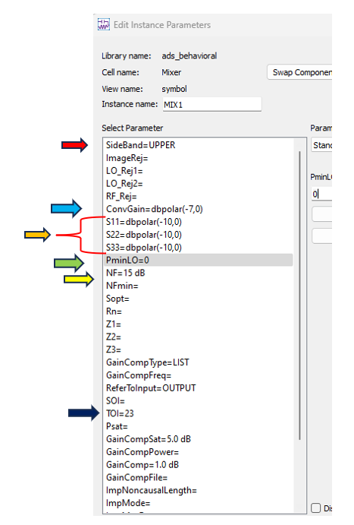
ADS Mixer Setup
ADS Mixer Setup
Setup the Mixer for the simulations:
Set the S-parameters (Orange Arrow).
Set the Conversion Gain (a.k.a. Gain) (Blue Arrow).
Output Third order intercept (Navy Blue Arrow).
Minimum LO power (Green Arrow).
Side band must be set to upper (Red Arrow).
NOTE: Use the values from the datasheet. The example does not necessarily have the correct values. You will need to find the required min LO power in the datasheet.
Note:
If the compression point or the TOI is not provided in the datasheet, you can fill either one but don’t have to fill in both.

Slide 26
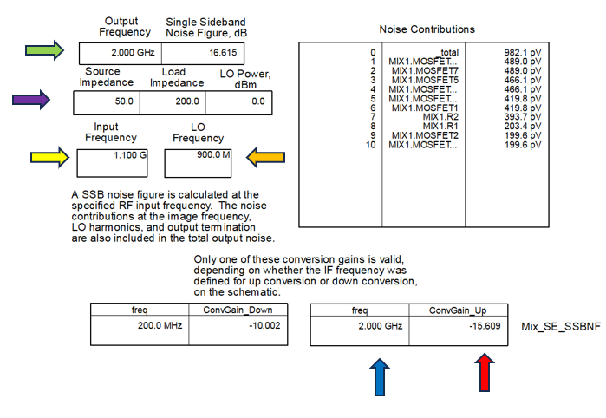
ADS Mixer Simulation –NF, Gain(SSB) Setup
Results Window in dds:
The results window will look something like this:
The Green Arrow is Output Frequency and noise figure of the device.
The Red Arrow is the conversion gain of the device.
The Blue Arrow is the output frequency
Check if your RF and LO frequencies are correct, indicated by the Yellow Arrow.
Check if the source and load impedances are set at 50 ohms and the LO power is at the appropriate value indicated by Purple Arrow.
NOTE: the example shown here does not necessarily have the same values as your design. This is only an example.

Slide 27
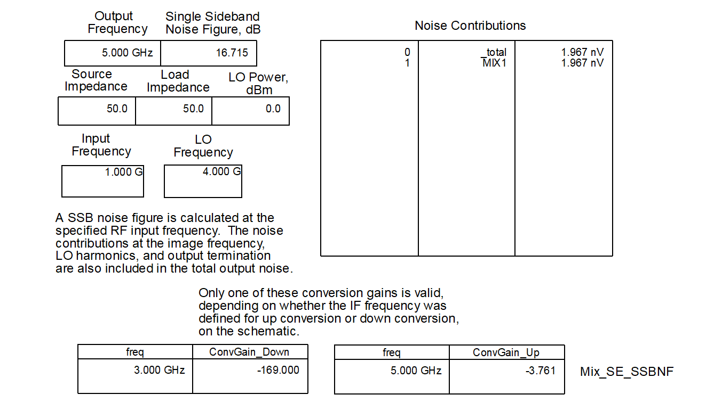
ADS Mixer Simulation –NF, Gain(SSB) Results
Report
Please place the screenshot here
Results Window, as on previous slide.

Slide 28
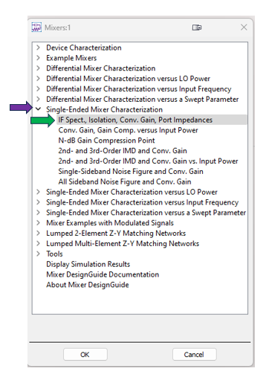
ADS Design Guide {Mixers-Spectrum}
Invoking the Design Guide
Now we want to simulate the mixer spectrum. We need to load a different design guide schematic.
Open a new blank schematic.
Select Single Ended Mixer (Purple Arrow).
Select the section highlighted by the arrow, this will open a template schematic (Green Arrow).

Slide 29
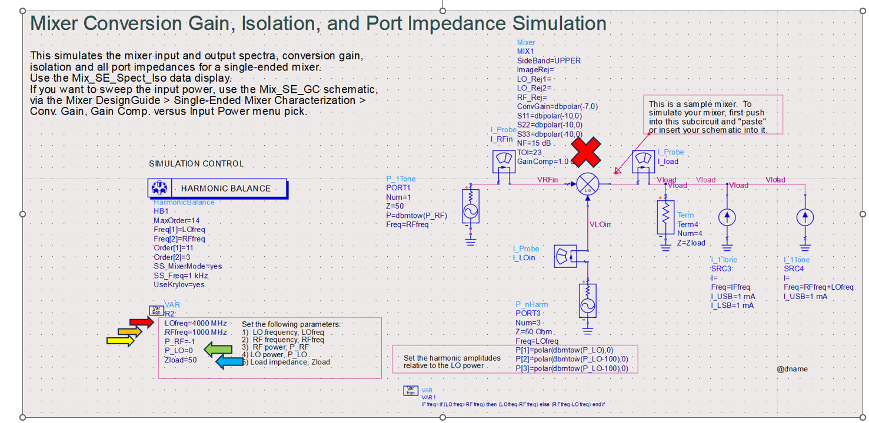
ADS Design Guide {Mixers-Spectrum}
MODIFY the Design guide schematic & simulate:
In the schematic attached to the design guide delete components marked with the “X”.
Replace the mixer in the center of the schematic with your mixer. This is the same instance that you used for the mixer NF, Gain simulation (see slides 8-9).
Change the LO frequency to the required value (Red Arrow).
Change the RF frequency to the required value (Orange Arrow).
Change the LO power to the required value (Green Arrow).
Change the RF power to the required value (Yellow Arrow).
If the impedances are not at 50 ohms change them to 50 ohms (Blue Arrow).
Run the simulation.

Slide 30
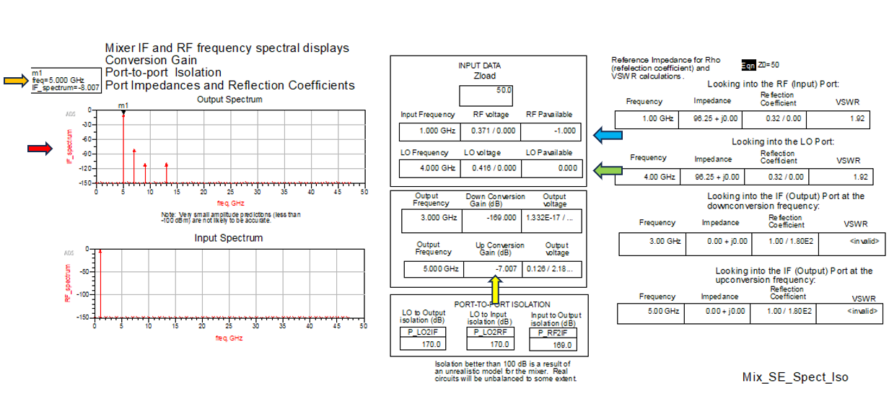
ADS Mixer Simulation –Spectrum Setup
Results Window in dds:
The Results window will look something like this shown to the right:
The Green Arrow is LO Frequency, power and voltage of the signal.
The Orange Arrow is the spectrum marker of the output fundamental.
The Blue Arrow is the RF Frequency, power and voltage of the signal.
The Red Arrow is the output spectrum.
Metrics Table

Slide 31
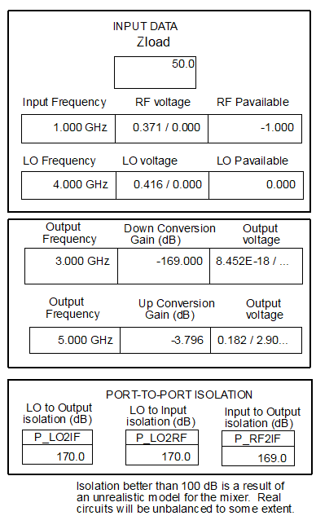
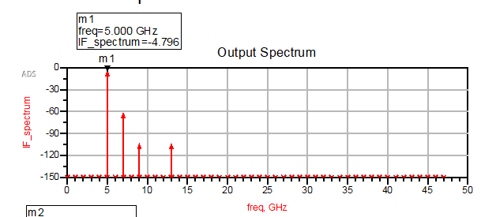
ADS Mixer Simulation –Spectrum Results
Report
Please place the screenshot here
Please place the screenshot here
Output Spectrum
Metrics Table (see prior slide)

Slide 32
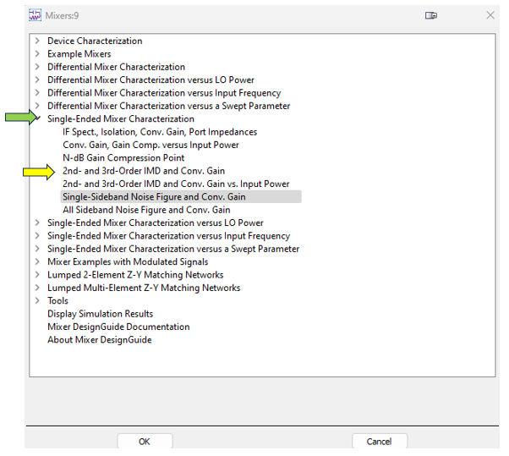
ADS Design Guide {Mixers TOI and Gain}
Invoking the Design Guide
Now we want to simulate the mixer third order intercept and gain using harmonic balance. We need to load a different design guide schematic.
Open a new blank schematic.
Select Single Ended Mixer (Green Arrow).
Select the section highlighted by the arrow, this will open a template schematic (Yellow Arrow).

Slide 33
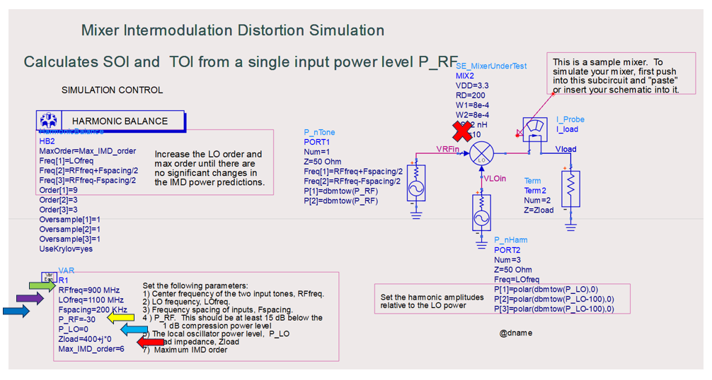
ADS Design Guide {Mixers TOI and Gain}
MODIFY the Design guide schematic & simulate:
In the schematic attached to the design guide delete components marked with the “X”.
Replace the mixer in the center of the schematic with your mixer. This is the same instance that you used for the mixer NF, Gain simulation (see slides 8-9).
Change the RF frequency to the required value (Green Arrow).
Change the LO frequency to the required value (Purple Arrow).
Change the frequency spacing value (Navy Blue Arrow). USE 200kHz as in the schematic.
Change the RF power to the required value (Yellow Arrow).
Change the LO power to the required value (Light Blue Arrow).
If the impedances are not at 50 ohms change them to 50 ohms (Red Arrow).
Run the simulation.

Slide 34
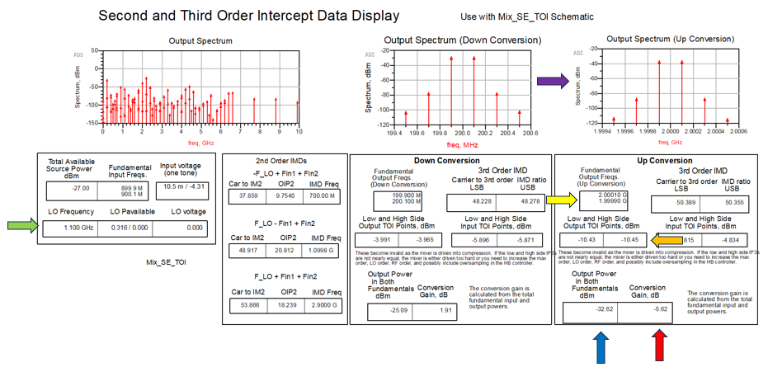
ADS Mixer Simulation - TOI and Gain Setup
Results Window in dds:
The Results window will look something like this shown to the right:
The Green Arrow is LO Frequency of the device.
The Red Arrow is the conversion gain of the device.
The Blue Arrow is the output power of both fundamentals indicated by Yellow Arrow.
Check the output spectrum indicated by the Purple Arrow.
Upconversion Table

Slide 35
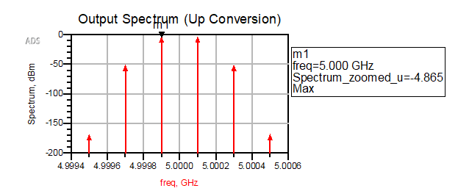
ADS Mixer Simulation -TOI and Gain Results
Report
Please place the screenshot here
Up conversion Output Spectrum

Slide 36
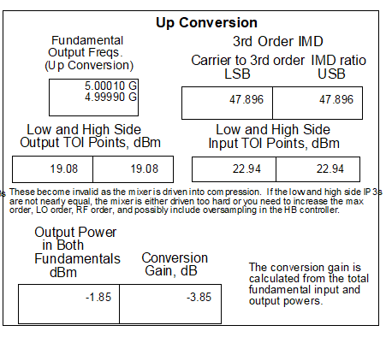
ADS Mixer Simulation -TOI and Gain Results
Report
Please place the screenshot here
Up conversion Output Table
This table is marked on Slide 18.

Slide 37
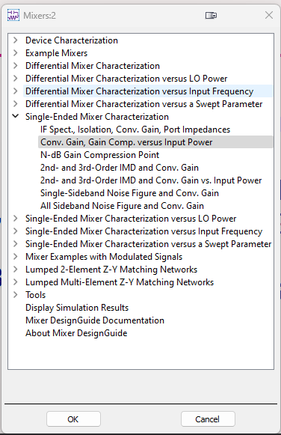
ADS Design Guide {Mixers-Compression Point}
Invoking the Design Guide
Select Single Ended Mixer (Purple Arrow).
Select the section highlighted by the arrow, this will open a template schematic (Green Arrow).

Slide 38
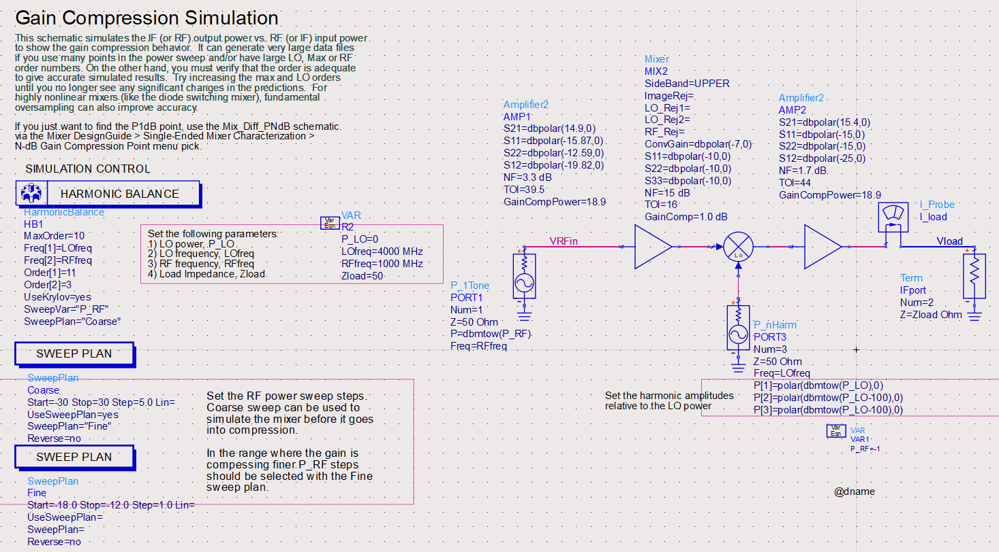
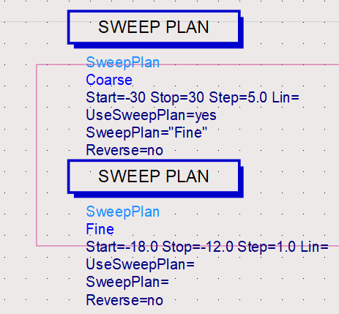
ADS Design Guide {Mixers-Compression Point}
Design guide schematic
In the schematic attached to the design guide delete components marked with the “X”.
Replace the mixer in the center of the schematic with your mixer.
Change the RF, LO frequencies and impedances to the required value (Purple Arrow).
Change the LO power to the required value (Light Blue Arrow).
Alter the power sweep plans as so (Red Arrow).
Run the simulation after.

Slide 39
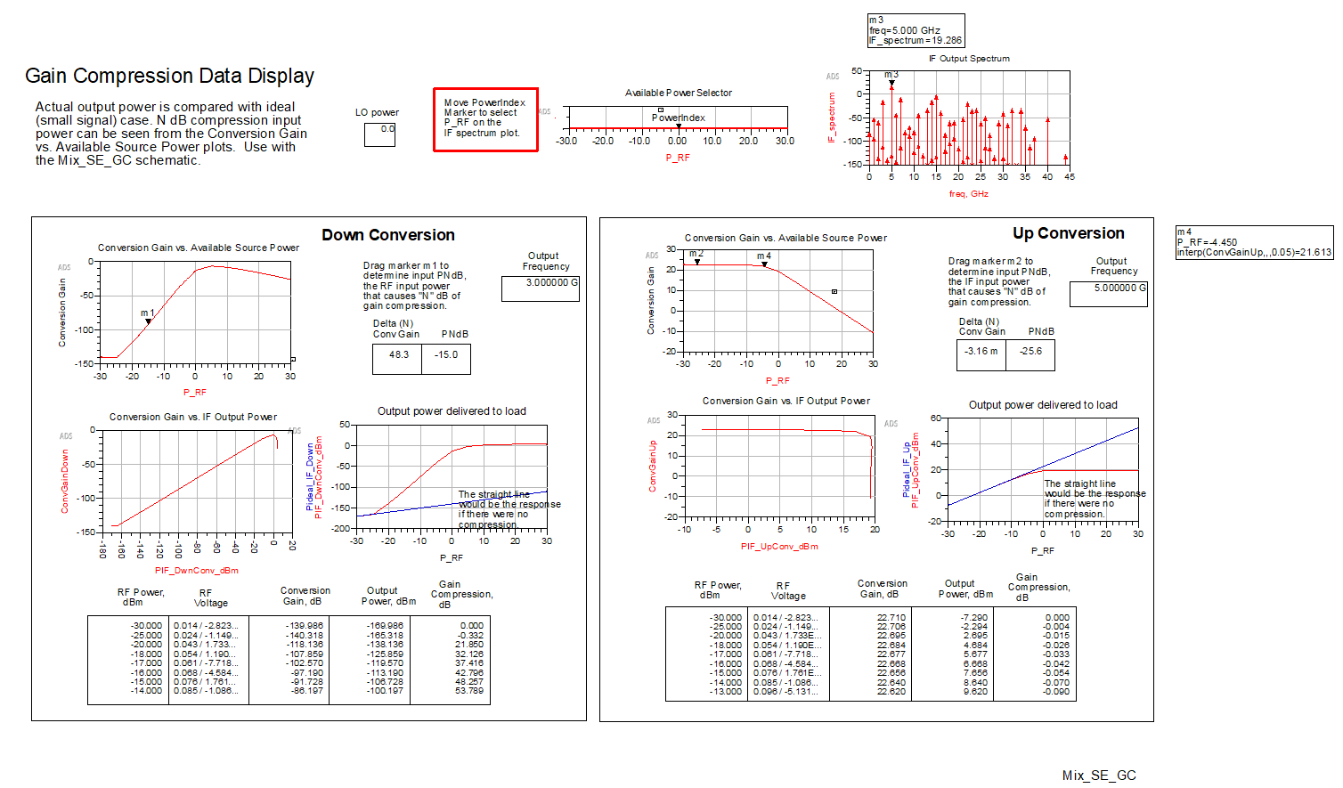
ADS Design Guide {Mixers-Compression Point}
Graph Window
The Graph window will look something like this.
Place a second marker on the compression graph as marked by the Red Arrow.
Not down the input power Pin(1-dB) value add the gain to it and use that as your Pout(1-dB) Op1-dB. Yellow Arrow
The table is highlighted with the green square place that in your report.

Slide 40
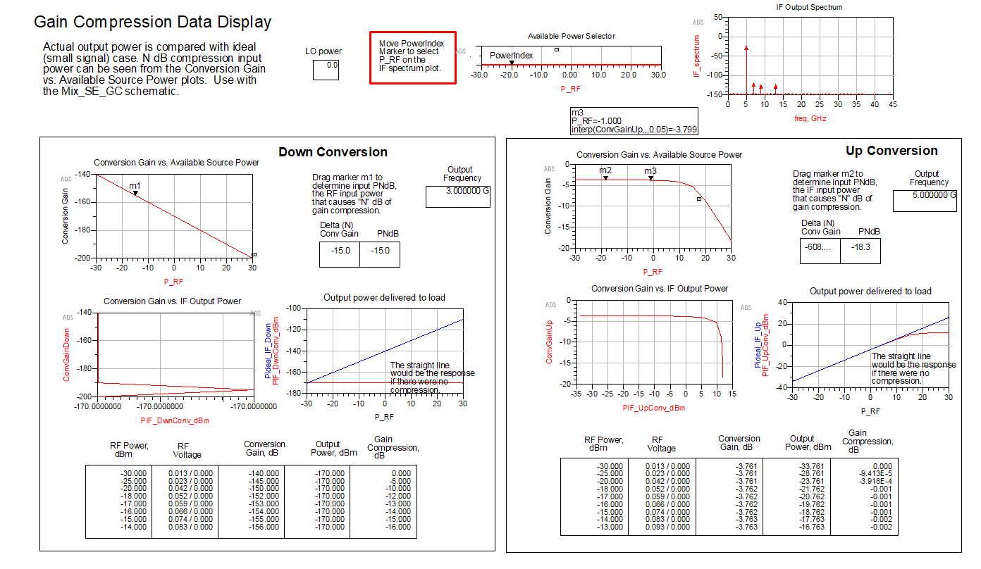
ADS Design Guide {Mixers-Compression Point}
Report
Please place the screenshot here
Output Table (entire table like previous slide)

Slide 41
Simulations of Transmitter
You may use the schematics that you created for the mixer simulations as a starting point to complete the Transmitter simulations.

Slide 42
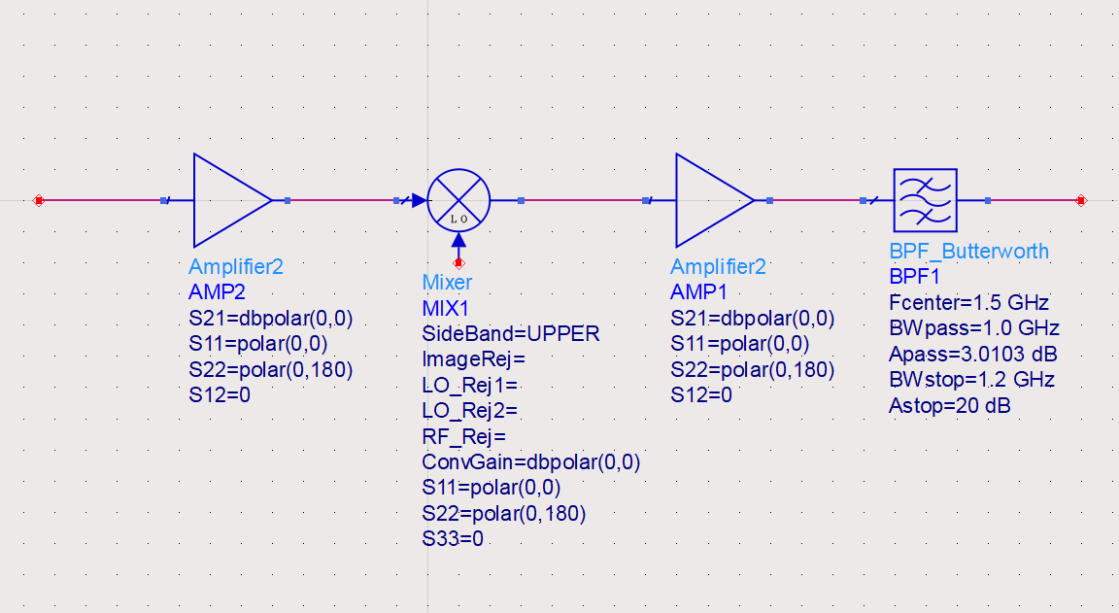
ADS Design Guide {Transmitter}
Now we simulate the transmitter.
Replace the mixer in the schematics of your prior testbenches with the entire transmitter, as shown in this slide.
The transmitter includes two amplifiers (one baseband, one RF), one upconversion mixer, and one filter.
The mixer is the same mixer you used in the previous setup (with parameters from the datasheet).
You will enter the parameters for the amplifiers and filter from their datasheets. See the next slides.
** see next slides for amplifier and filter component information and setup.
** use the datasheets (same as Part 1) to find/enter the performance parameters of each component.
** the parameter values shown in this picture are not the actual values used in your transmitter.

Slide 43
ADS Transmitter Testbenches
You will repeat all of the simulations that were made for the Mixer again for the Transmitter.
For each of the four schematics (a.k.a. testbenches) that you created for the Mixer, you will replace your mixer with the full transmitter (similar to the example shown to the right).
You will simulate the Transmitter in each of these four testbenches.
You will report your results in the following slides.

Slide 44


Insert Component from Palette
Amplifier
Mixer
How to insert your RF components:
The components in the design guide schematic are replaced with ideal (behavioral model) components from the component palette.
Search for the component, as shown to the right, in the component palette.
Place each component into the schematic in a lineup similar to what is shown on the previous slide.
See next slides for amplifier and filter setup.
The mixer is the same mixer that you used for your mixer simulations.
Filter

Slide 45

ADS Amplifier Setup
ADS Amplifier setup:
Setup the amplifier(s) for the simulations.
Set the S-parameters (Orange Arrow).
Set the Noise Figure (Blue Arrow).
Output Third order intercept (Red Arrow).
Output Gain Compression power (Green Arrow).
NOTE: Use the values from the datasheet. The example does not necessarily have the correct values.
Note:
If the compression point or the TOI is not provided in the datasheet, you can fill either one

Slide 46

ADS Filter Setup
ADS Filter setup
Setup the filter for the simulations.
Set the center frequency as 5GHz (Blue Arrow).
Set the pass bandwidth to be 0.5 GHz (Red Arrow).
Set the stop bandwidth to be 1GHz (Orange Arrow).
Set the filter order to 6 (Yellow Arrow).

Slide 47

ADS Transmitter Simulation - NF, Gain(SSB) Results
Report
Please place the screenshot here
Results Window, similar to Slide 10.
Refer to slides 6-10 for setup.

Slide 48


ADS Transmitter Simulation –Spectrum Results
Report
Please place the screenshot here
Output Spectrum
Metrics Table

Slide 49

ADS Transmitter Simulation -TOI and Gain Results
Report
Please place the screenshot here
Up conversion Output Spectrum

Slide 50

ADS Transmitter Simulation -TOI and Gain Results
Report
Please place the screenshot here
Up conversion Output Table

Slide 51

ADS Design Guide {Mixers-Compression Point}
Report

Slide 52
ADS Transmitter Simulation Summary}
Report
Spec | Hand Calculations | MATLAB | ADS
Gain (dB) | 28.3 | 28.3 | 27.874
OP1-dB (dBm) | 25.622 | 25.6221 | 25.903
OIP3 (dBm) | 35.622 | 35.6221 | 29.83
Output Fundamental Power (dBm) | 27.3 | 27.3 | 25.704
Compare the Hand Calculation from Project 3 Part 1, the MATLAB simulations from Project 3 Part 1, and the ADS simulations from Project 3 Part 2 (this report).
Comment on discrepancies between the various results. What may be the cause?

Slide 53
{Appendix} – Links to Datasheets
Compare the Hand Calculation from Project 3 Part 1, the MATLAB simulations from Project 3 Part 1, and the ADS simulations from Project 3 Part 2 (this report).
Comment on discrepancies between the various results. What may be the cause?
Every software tool may employ distinct models and assumptions concerning components like amplifiers and mixers. While hand calculations may adopt simplified models for rapid estimation, software platforms such as MATLAB and ADS often rely on more intricate and precise models. Inconsistencies may arise if the assumptions within these models do not align.
Datasheet Links (also on Canvas w/annotations):
ffc5071_5072_data_sheet-1506879.pdf (mouser.com)
ADL5535.pdf (analog.com)
GRF5511DS-1714274.pdf (mouser.com)

